Slide 1


Lease Late Charge Waiver Service
API Specification
Innovate
value-focused
digital & data solutions
At Speed.
Harmonize
alignment-focused organizational functions
At Scale.
Execute
customer-focused experiential services
With Confidence.

Slide 2

Enterprise Service Platform (ESP)
Lease Late Charge Waiver Service – API Specification

Slide 3
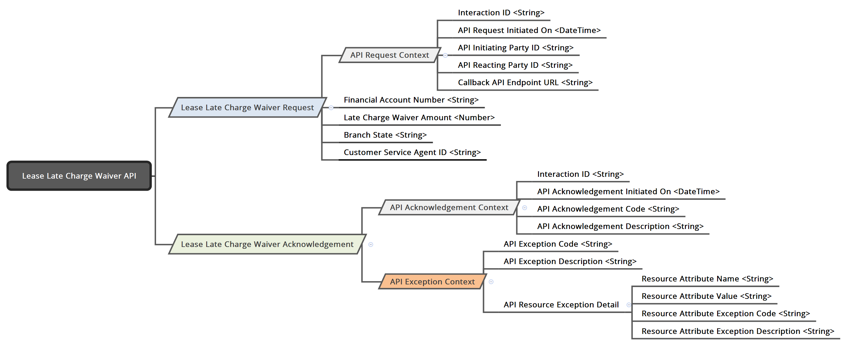
Lease Late Charge Waiver Service : ‘API Specification’ – Version 0.1

Slide 4
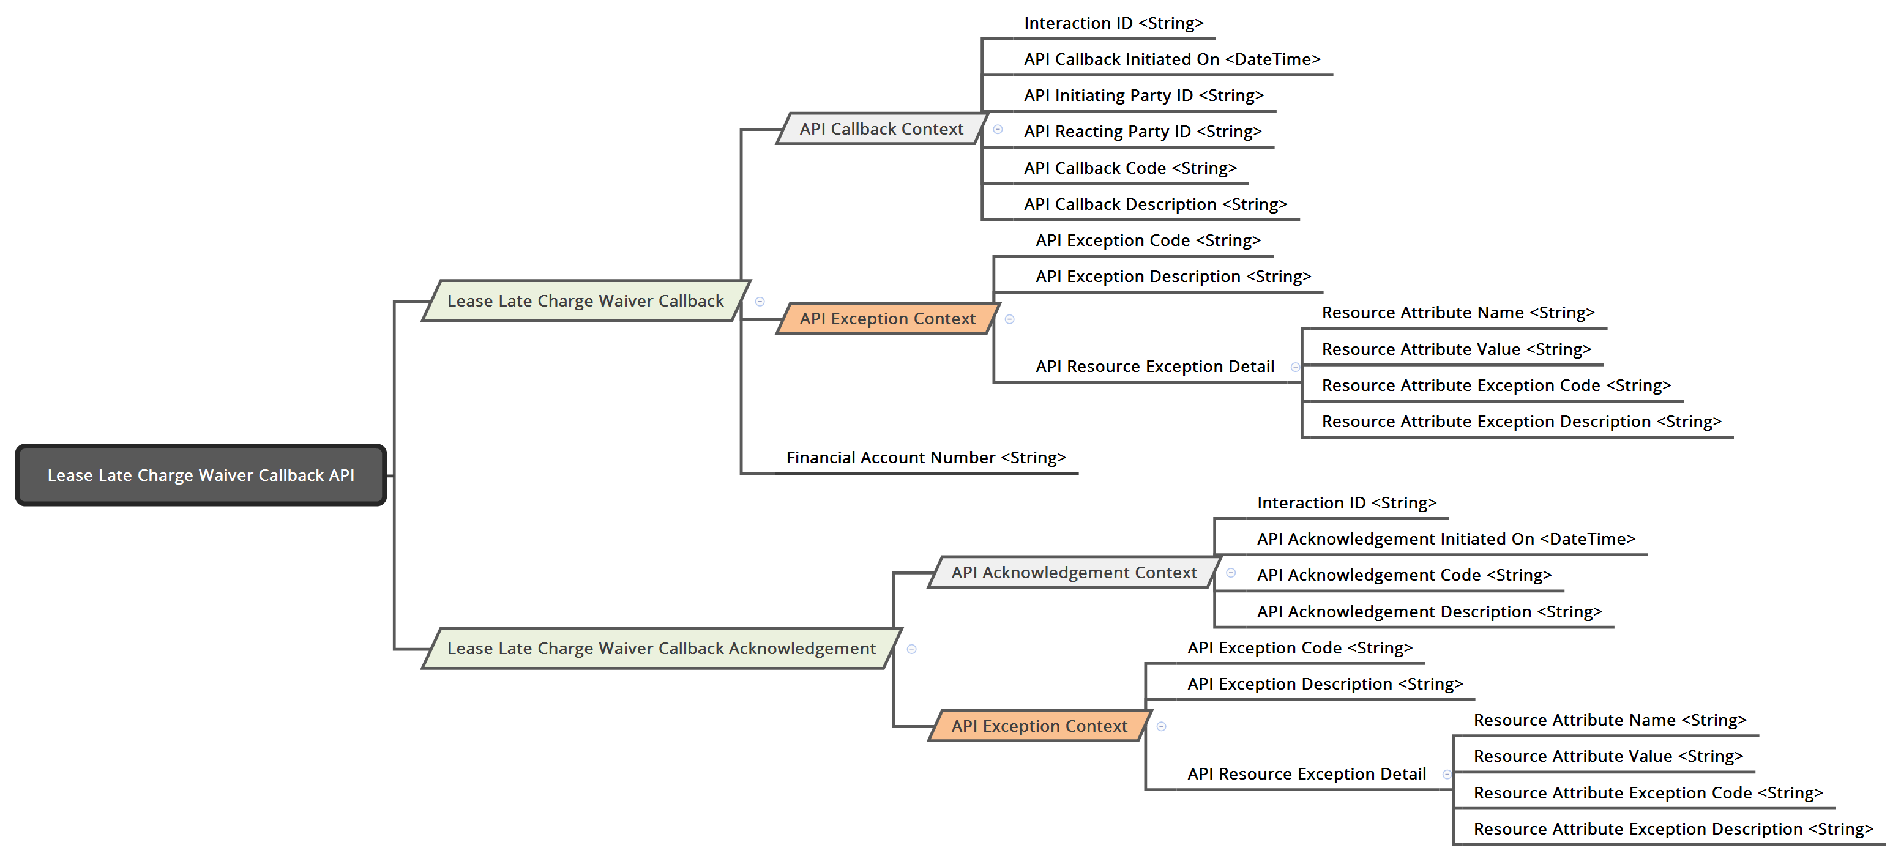
Lease Late Charge Waiver Service : ‘Callback API Specification’ – Version 0.1

Slide 5
Lease Late Charge Waiver Service : Information Element Specification
Information Item:
Financial Account Number *
Optionality:
Required
Description:
Financial Account Number is the unique identifier of a Lease Account within CEP.
Behavior:
Lease Financial Account Number is a Composite Key that comprises of: Region, Branch & Lease Number
[Region][Branch][Lease Number]
[99][9999][AAAAA]
Client Behavior:
Client must always provide Lease Financial Account Number for the given Late Charge Waiver transaction.
Service Behavior:
Service must validate the existence of Financial Account Number in the Lease System.
Service extract Region, Branch & Lease Number from Financial Account Number to invoke Lease IMS Transaction APIs
Service must process the Late Charge Waiver transaction in the Lease System for the given Lease Financial Account Number.
Input:
Yes
Output:
No
Data Type:
String
Format:
[99][999][AAAAA]
Default:

Slide 6
Lease Late Charge Waiver Service : Information Element Specification
Information Item:
Late Charge Waiver Amount *
Optionality:
Required
Description:
Late Charge Waiver Amount is the Late Charge Amount requested by Lease Customer to be Waived for his Account.
Behavior:
Client Behavior:
Client must always provide the Late Charge Waiver for the given Late Charge Waiver transaction.
Service Behavior:
Service must process the Late Charge Waiver transaction in the Lease System with the given Late Charge Waiver Amount.
Input:
Yes
Output:
No
Data Type:
Number
Format:
999999999.99
Default:

Slide 7
Lease Late Charge Waiver Service : Information Element Specification
Information Item:
Branch State *
Optionality:
Required
Description:
Branch State represents the State of Branch Location used to uniquely Identify a Lease Account in LeMans.
Behavior:
Client Behavior:
Client must always provide the Branch State for the given Late Charge Waiver transaction.
Service Behavior:
Service must pass the Branch State when invoking Lease Late Charge Waiver API on zOSConnect.
Input:
Yes
Output:
No
Data Type:
String
Format:
AA
Default:

Slide 8
Lease Late Charge Waiver Service : Information Element Specification
Information Item:
Customer Service Agent ID *
Optionality:
Required
Description:
Customer Service Agent ID is the ID of the Customer Service User who initiated Late Charge Waiver request for the lease customer account on the Client System.
Behavior:
Client Behavior:
Client must always provide the Customer Service Agent ID of the User who initiated the Late Charge Waiver request.
Service Behavior:
Service must record Customer Service Agent ID information for audit and logging purposes.
Input:
Yes
Output:
No
Data Type:
String
Format:
Default:

Slide 9
Lease Late Charge Waiver Service : Information Element Specification
Information Item:
API Request Context *
Optionality:
Required
Description:
API Request Context provides the detailed context of the specific instance of API Request from Client for processing Late Charge Waiver transaction.
Behavior:
API Request Context captures the following information:
Interaction ID - Globally Unique Identifier assigned by Client System representing the instance of an interaction with the Late Charge Waiver Service, used to correlate the Client-Service Interaction.
API Callback Initiated On - Date & Time at which API Request was Initiated by Client in ISO 8601 format.
API Initiating Party ID - Unique Identifier representing the Party/System Initiating the API.
API Reacting Party ID - Unique Identifier representing the Party/System Reacting to the API.
Callback API Endpoint URL - Fully Qualified Enpoint URL with Resource Path for Asynchronous Response Callback from Late Charge Waiver Service
Client Behavior:
Client must provide the API Request Context when invoking Late Charge Waiver API.
Service Behavior:
Service must Log the API Request Context information for Auditing & Monitoring purpose.
Input:
No
Output:
Yes - Optional
Data Type:
Object
Format:
Default:

Slide 10
Lease Late Charge Waiver Service : Information Element Specification
Information Item:
API Acknowledgement Context *
Optionality:
Required
Description:
API Acknowledgement Context provides the detailed context of the Receipt Acknowledgement from Service to Client confirming the receipt of API Request from Client for Late Charge Waiver transaction.
Behavior:
API Acknowledgement Context captures the following information:
Interaction ID - Globally Unique Identifier assigned by Client System representing the instance of an interaction with the Late Charge Waiver Service, used to correlate the Client-Service Interaction.
API Acknowledgement Initiated On - Date & Time at which API Acknowledgement was Initiated by Late Charge Waiver Service in ISO 8601 format.
API Acknowledgement Code - Return code from the Late Charge Waiver Service indicating that the Late Charge Waiver transaction was enqueued successfully for asynchronous processing.
API Acknowledgement Description - Provides the description for Return Code from the Late Charge Waiver Service indicating that the Late Charge Waiver transaction was enqueued successfully for future processing.
Client Behavior:
Client must log the API Acknowledgement Context information for Audting & Monitoring purpose.
Service Behavior:
Service must provide the API Acknowledgement Context information when acknowledging Client API Request.
Note:
Use appropriate HTTP status codes in “API Acknowledgement Code“ as applicable and keep it agnostic of the transport protocol.
API Acknowledgement Code : 202 – “Late Charge Waiver Transaction Request Accepted & Enqueued for Asynchronous Processing”
API Acknowledgement Code : 400 – “Invalid Request, Structural Validation Failed”
Input:
No
Output:
Yes - Optional
Data Type:
Object
Format:
Default:

Slide 11
Lease Late Charge Waiver Service : Information Element Specification
Information Item:
API Exception Context +
Optionality:
Description:
API Exception Context provides the detailed context to the Exception Occurred in processing the Late Charge Waiver transaction.
Behavior:
API Exception Context captures the following information:
API Exception Code - Exception code from the Late Charge Waiver Service indicating that the Late Charge Waiver transaction was not processed successfully.
API Exception Description - Provides the description for Exception Code from the Late Charge Waiver Service indicating that the Late Charge Waiver transaction was not processed successfully
API Resource Exception Detail: Array of references to the Resource Attribute that caused the Exception
Resource Attribute Name - Name of the Resource Attribute that cased the Exception.
Resource Attribute Value - Value of the Resource Attribute that cased the Exception.
Resource Attribute Exception Code - Exception Code representing the type of error caused by the given Resource Attribute.
Resource Attribute Exception Description - Description of the Exception Code representing the type of error caused by the given Resource Attribute.
Client Behavior:
Client can use API Exception Context to analyze & debug the problem in processing Late Charge Waiver transaction.
Service Behavior:
Service can use API Exception Context to analyze & debug the problem in processing Late Charge Waiver transaction.
Input:
No
Output:
Yes - Optional
Data Type:
Object
Format:
Default:

Slide 12
Lease Late Charge Waiver Service : Information Element Specification
Information Item:
API Callback Context *
Optionality:
Required
Description:
API Callback Context provides the detailed context of the Callback Response from Service for the specific instance of API Request from Client for processing Late Charge Waiver transaction.
Behavior:
API Callback Context captures the following information:
Interaction ID - Globally Unique Identifier assigned by Client System representing the instance of an interaction with the Late Charge Waiver Service, used to correlate the Client-Service Interaction.
API Callback Initiated On - Date & Time at which Callback API was Initiated by Server in ISO 8601 format.
API Initiating Party ID - Unique Identifier representing the Party/System Initiating the API.
API Reacting Party ID - Unique Identifier representing the Party/System Reacting to the API.
API Callback Code - Response Code from the Late Charge Waiver Service indicating the status of Late Charge Waiver transaction.
API Callback Description - Provides the description for Response Code from the Late Charge Waiver Service indicating the status of Late Charge Waiver transaction
Client Behavior:
Client must log the API Callback Context information for Audting & Monitoring purpose.
Service Behavior:
Service must provide the API Callback Context information when invoking Late Charge Waiver Callback API
Note:
Use appropriate HTTP status codes in “API Callback Code” as applicable and keep it agnostic of the transport protocol.
API Callback Code: 200 – “Late Charge Waiver Transaction Request Processed Successfully”
API Callback Code: 503 – “Late Charge Waiver Transaction Initial Attempt Failed, Enqueued for Retry”
API Callback Code: 500 – “Error processing Late Charge Waiver Transaction Request”
Service should report “Retry Processing” thru Callback API.
Input:
No
Output:
Yes - Optional
Data Type:
Object
Format:
Default:

Slide 13

Copyright © 2012-2017 Steerwise Inc. All Rights Reserved.
Steerwise Inc. disclaims all warranties with regard to this material and contents herein, including all implied warranties of suitability and fitness for any particular purpose. In no event shall Steerwise Inc. be liable for any special, incidental, indirect or consequential damages or any damages whatsoever resulting from loss of use, data or profits, whether in an action of contract, negligence or other tortious action, arising out of or in connection with the use or inability to use this material or performance of this material.
All or specific content in this material is protected by copyright, and permission must be obtained from the owner prior to any prohibited reproduction, storage in a retrieval system, or transmission in any form or by any means, electronic, mechanical, photocopying, recording or likewise. No one is allowed to remove or modify proprietary markings or legends, logos, trademarks, trade secrets, copyright and rights notices from this material under any circumstances.
This copyrighted material is intended for use by the licensed customers only. None of the information found here can be used for commercial gain of any kind including resale or reproduction for profit. No one is allowed to copy or sell or distribute any of the material or contents thereof or any derivate works to any party as their own, or of any other party, without explicitly obtaining either a commercial or non-commercial license from Steerwise Inc.
Business Technology Architecture® is a registered trademark of Steerwise Inc. Business Value First™, Innowise™, Alignwise™, Performwise™, Meaning-Oriented-Modeling™, Meaning-Oriented-Integration™, Business Being™, Data Efficacy & Data Excellence™ are trademarks of Steerwise Inc.
Any inquiries regarding this material, requests for usage rights for the material or contents included herein, should be sent by email to info@steerwise.com

